Slide 1
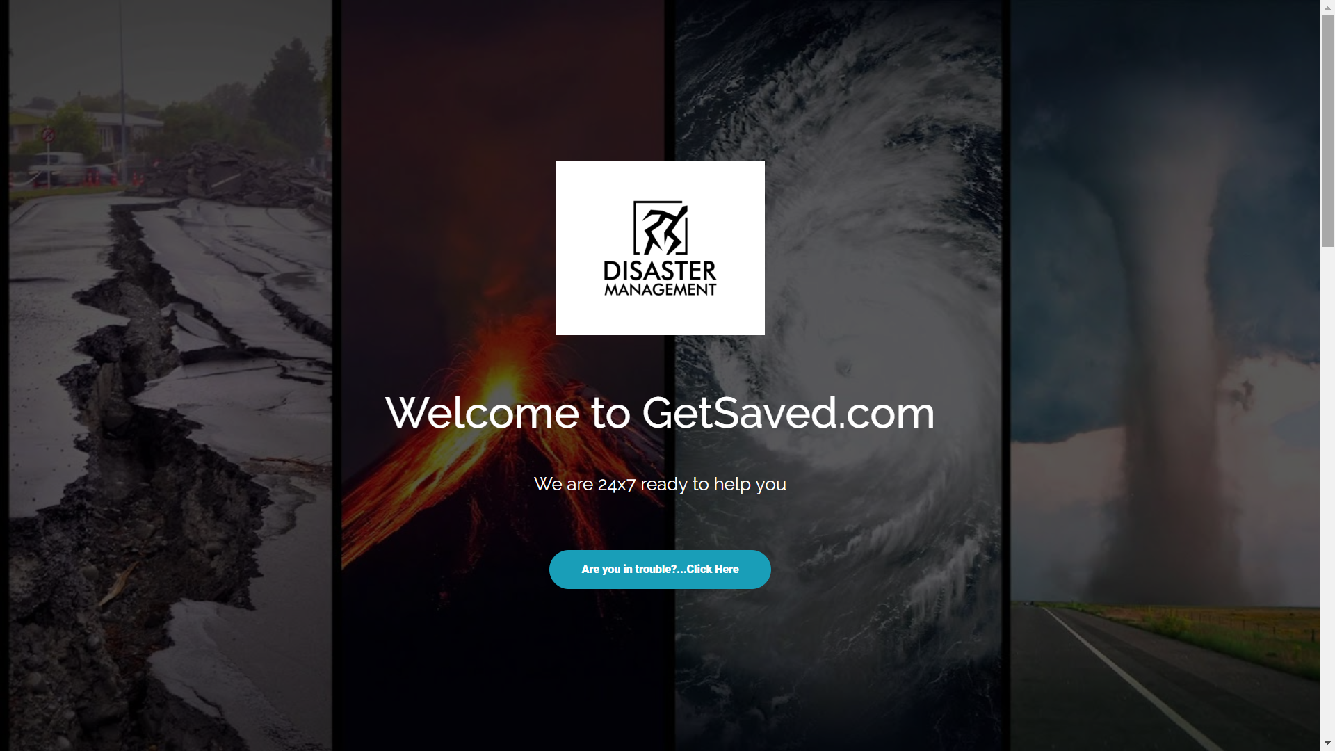


Slide 2

GetSaved.com
(we are also in app store)
User Panel
Admin Panel
Information Page
Registration
(With exact latt. & long.)
Weather
Report
Control Panel
Rescue Team
Area (Multiple Location)
Our Rescue Team
Nearest Police Station
Nearest Hospital
Fire Brigade

Slide 3
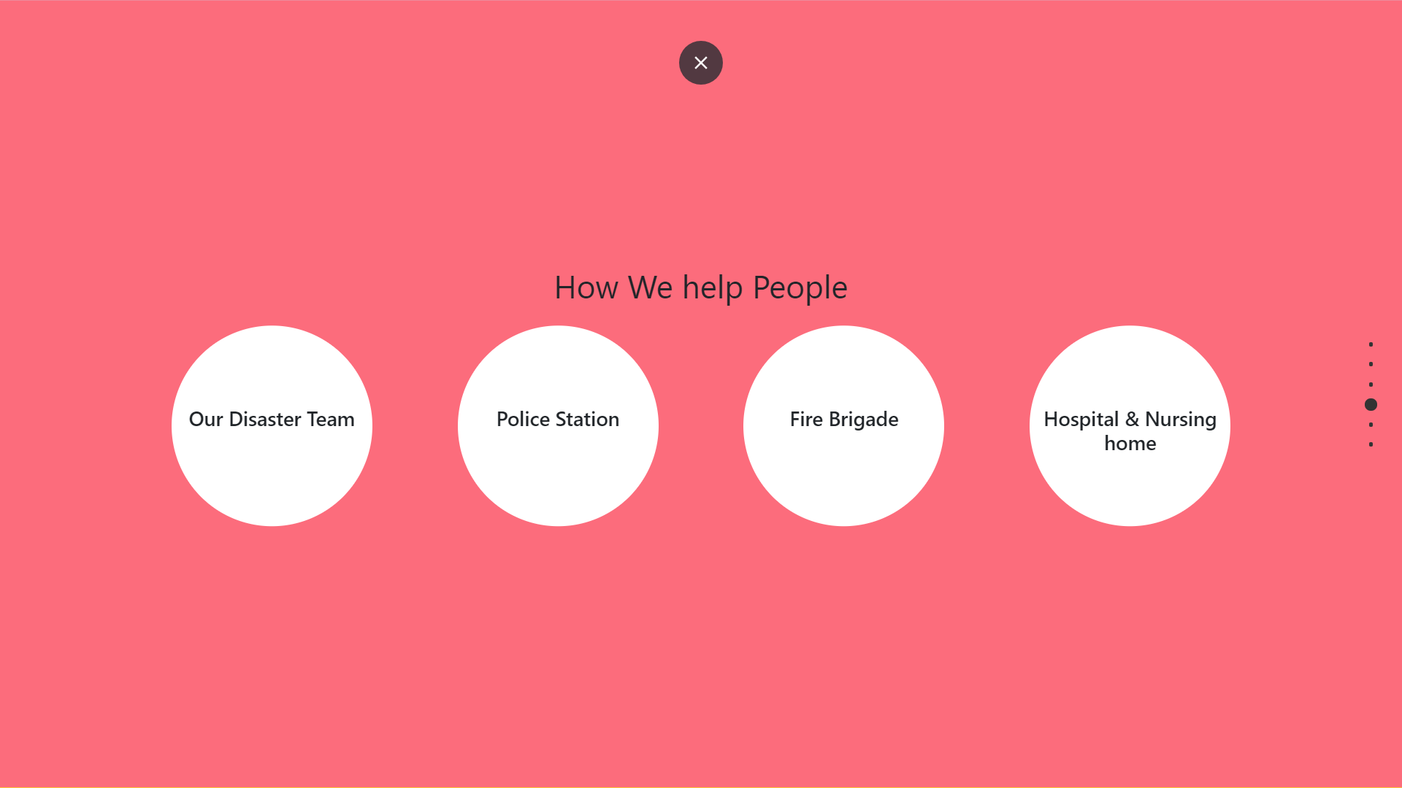

Slide 4
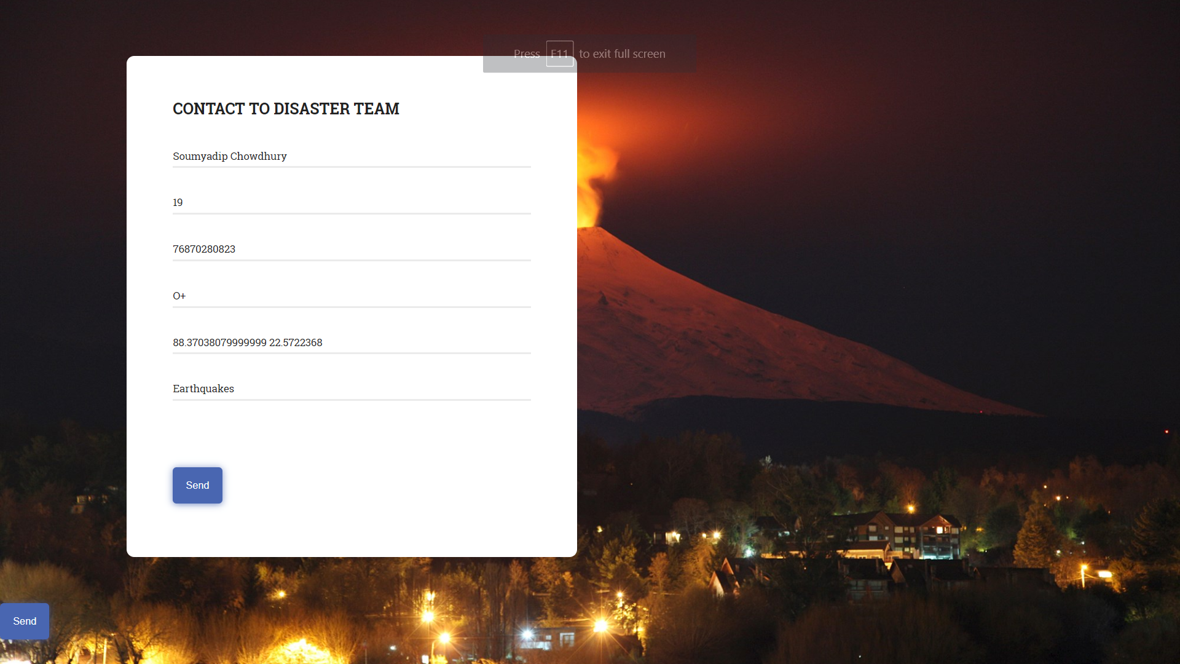

Slide 5
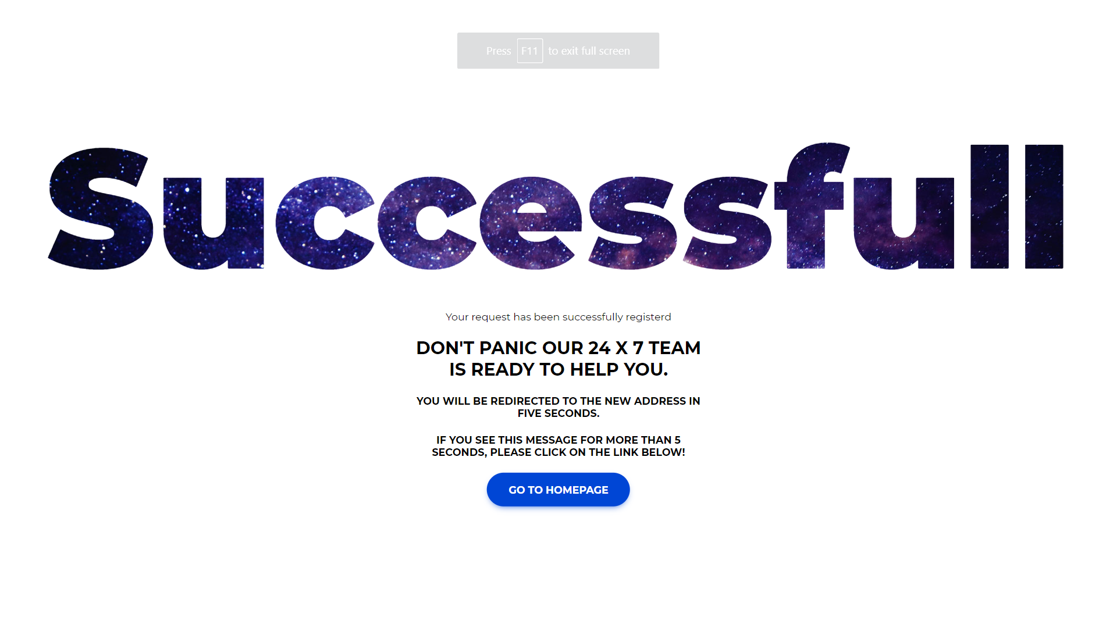

Slide 6
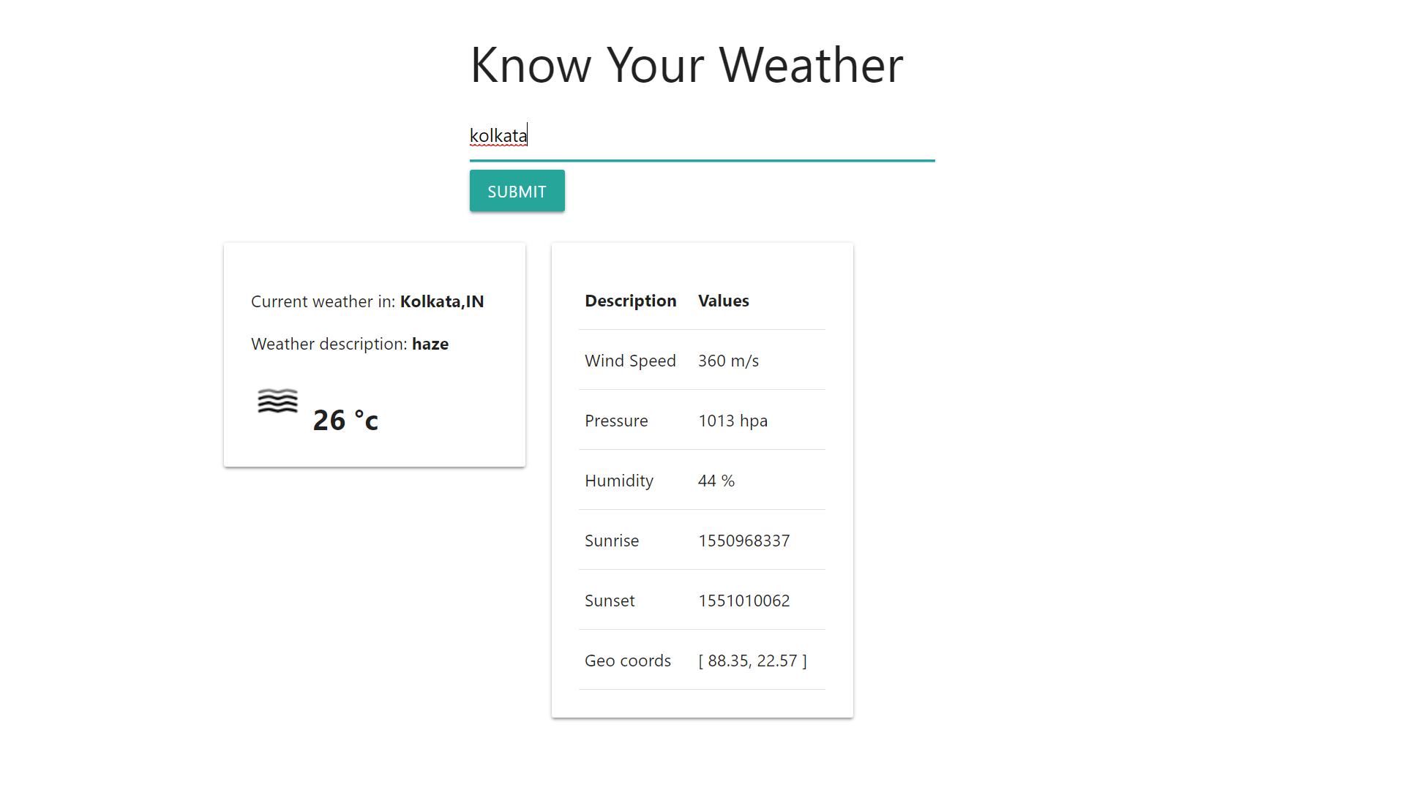

Slide 7
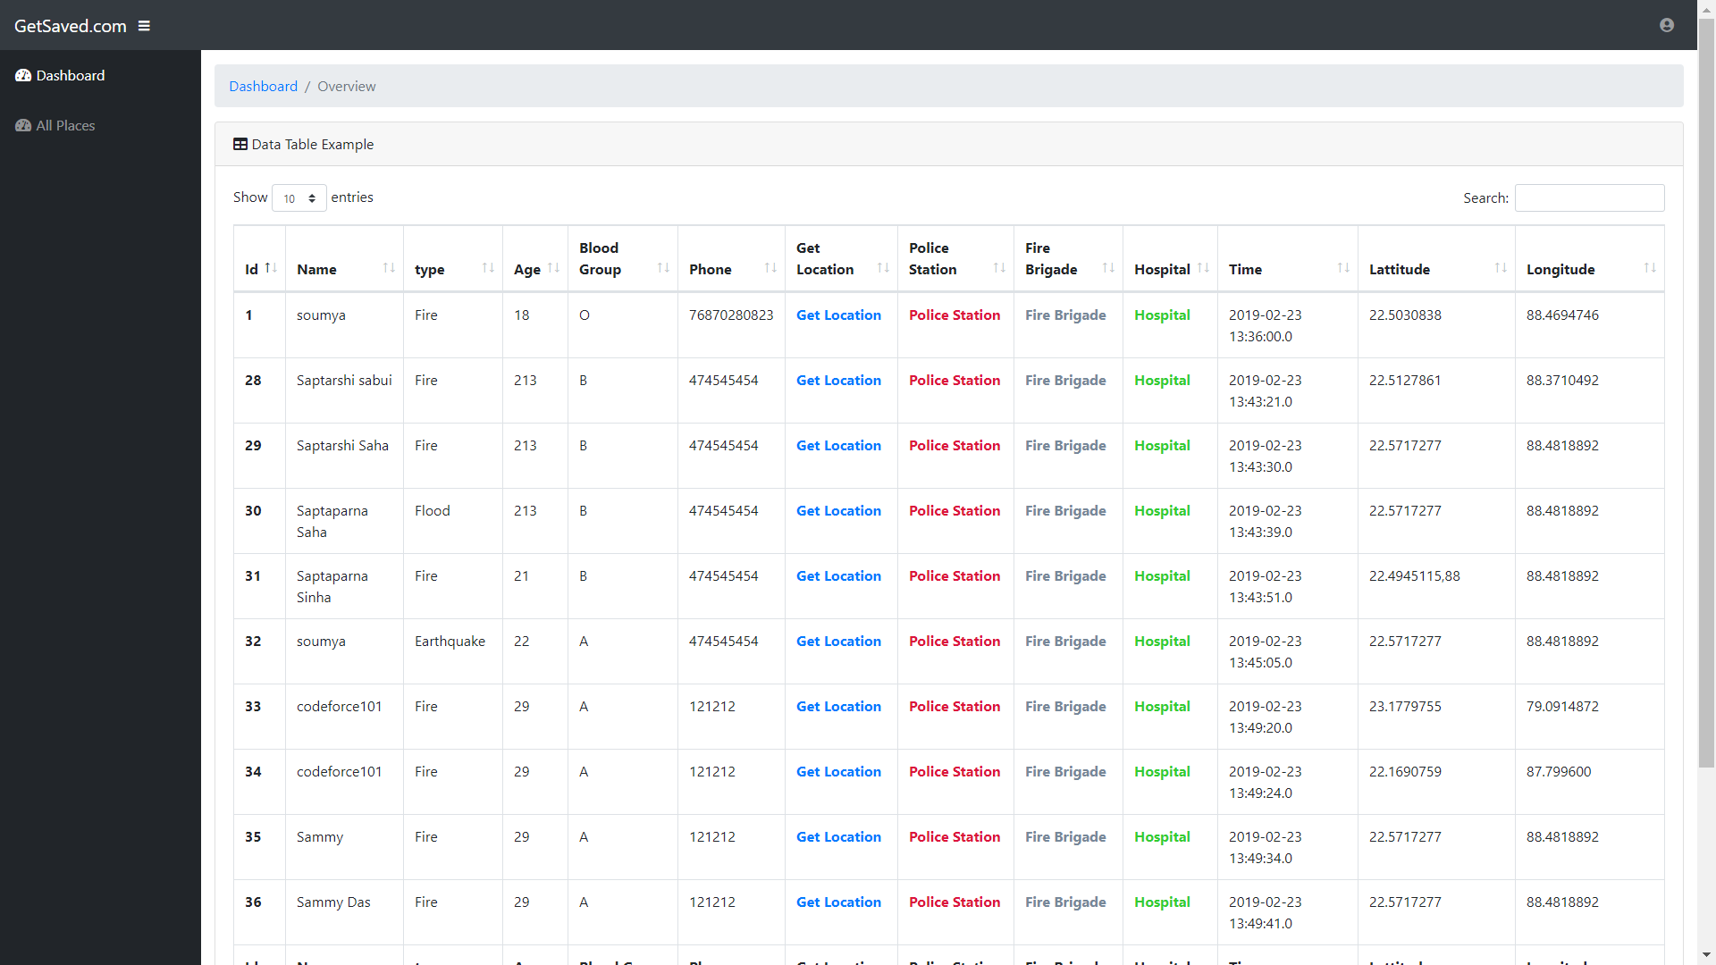

Slide 8
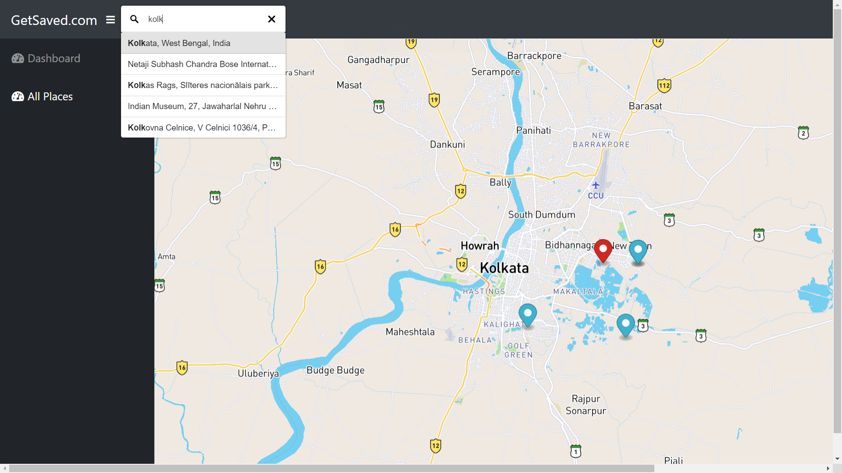

Slide 9
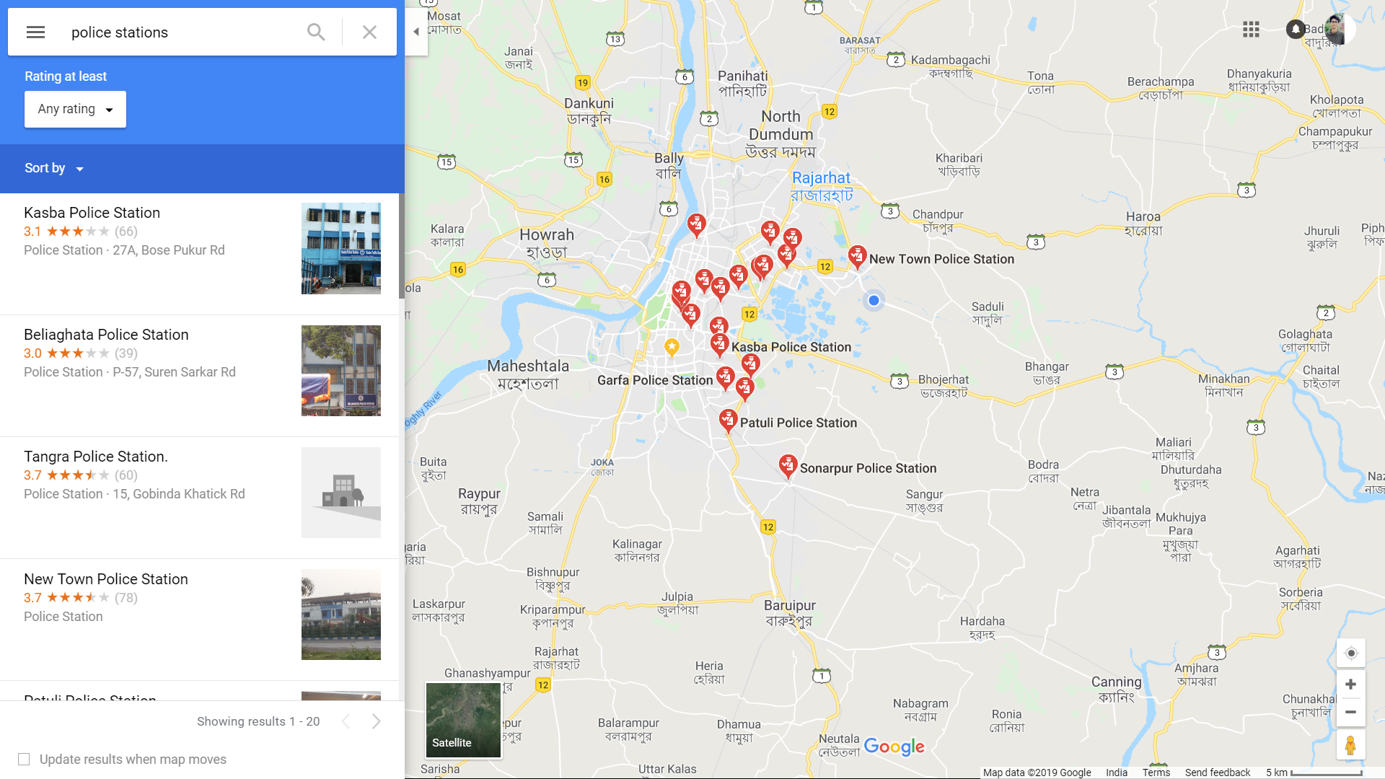

Slide 10
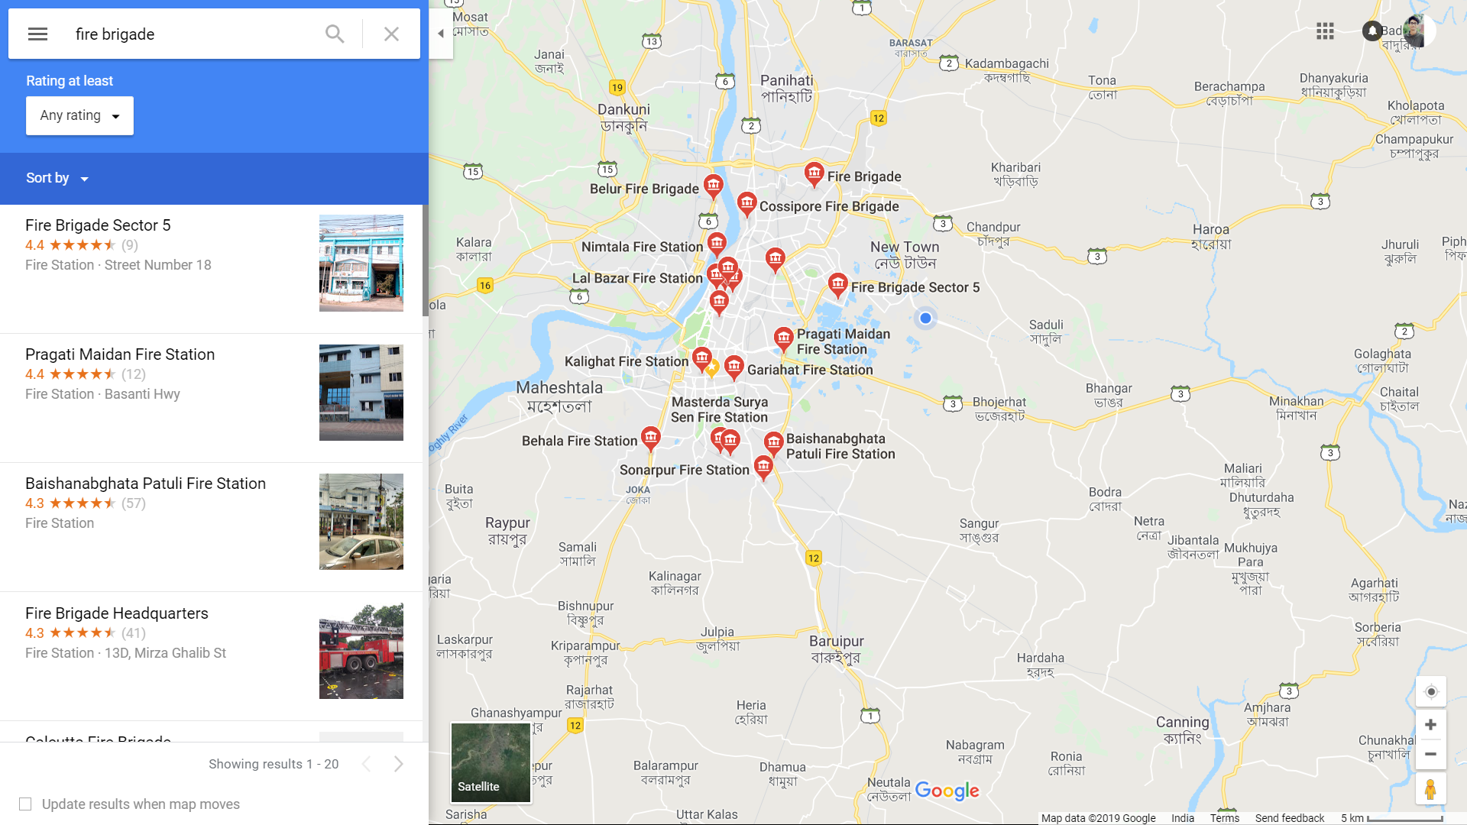

Slide 11
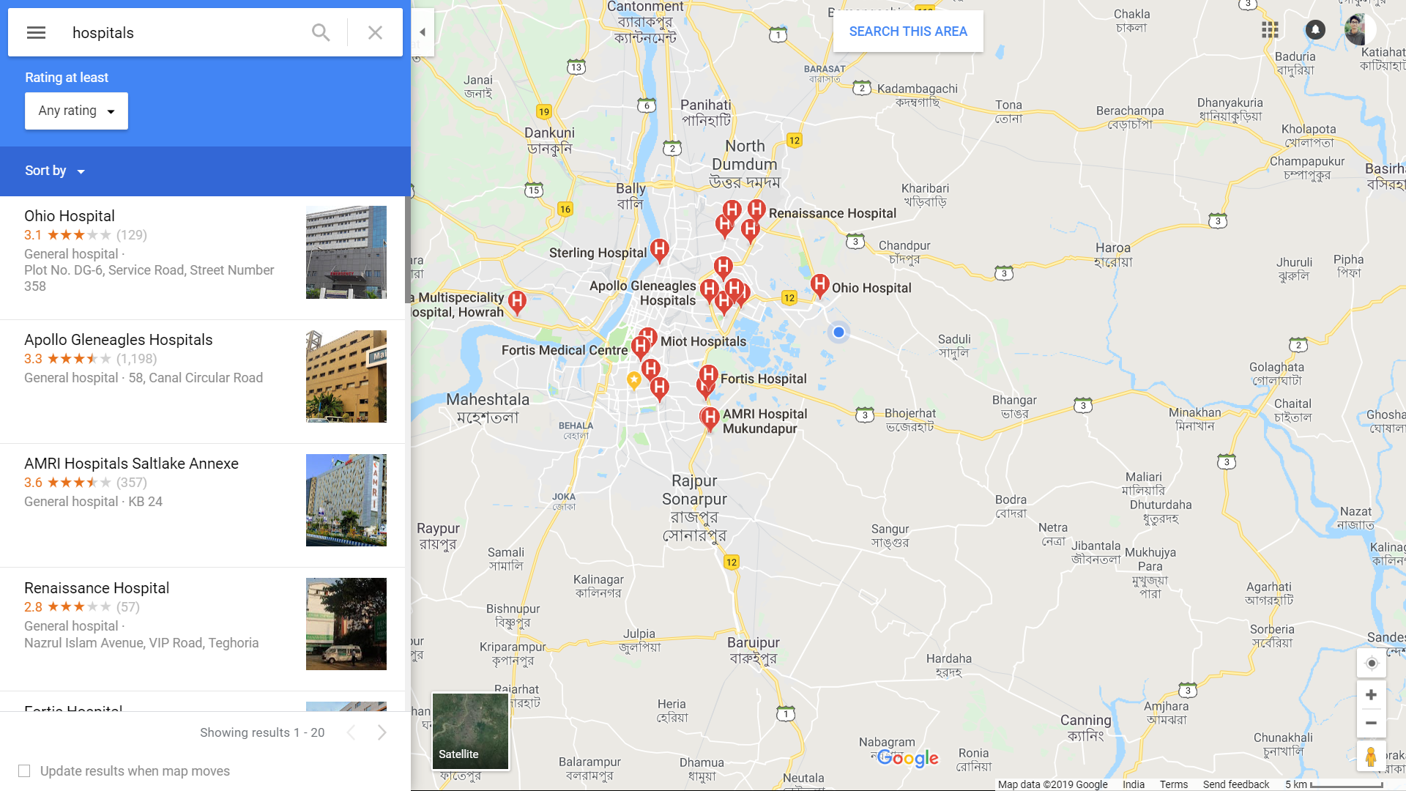

Slide 12
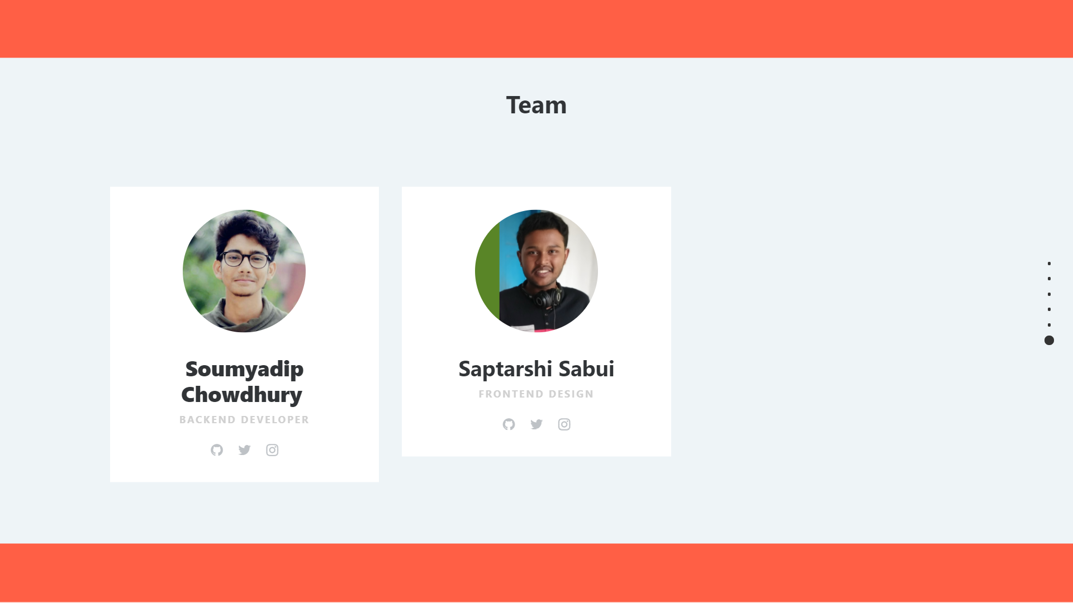

Slide 13
THANK YOU
GetSaved.com
(UsingHTML5,CSS,BOOTSTRAP,JAVASCRIPT,JSP,SERVLET,JSTL,MYSQ,API)
Soumyadip Choudhury & Saptarshi Sabui
Ureckathon

